Slide 1
2012 Practise paper coast.
Manufacturing [1 mk]
There must be reference to location, max 1 for a list rather than a sense of place.
1 -2 mks – Little attempt, poor examples, no structure, little terminology
If you see a blue box, this gives you the answer to a question and the marks for that answer.
If you see an answer in a purple box that information will be linked to advice on how to gain top marks in your answer.
Bangladesh [1 mk]
6 -8 mks – Detailed, Structured answer, Specific examples, good use of terminology
If you see an answer with a red box this means a mark can be obtained by including an example/name or case study
Test your self on each of the exam questions and reveal the answers to see if your correct.
If you see this on a question then the question is levelled and greater marks are obtained as explained above

Slide 2
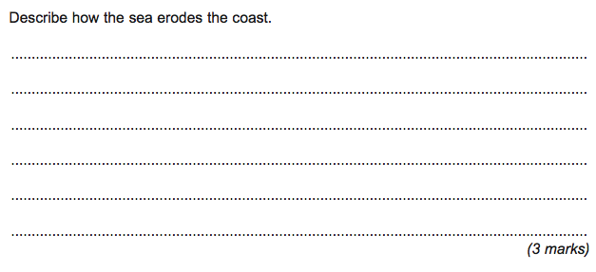
The sea erodes the coast via hydraulic power – which is the sheer force of the water on the coast (1)
abrasion – where material being carried is hurled at the cliffs (1) and this acts like a sandpapering effect (1)
attrition – where material being carried knocks into other rock fragments (1) and they become smaller/more rounded (1)
solution where certain rocks such as chalk and limestone (1) dissolve in sea water (1).
Swash/backwash – stronger backwash removing beach material.(1)

Slide 3
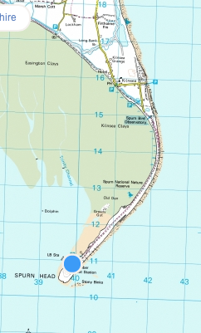
^{Nature reserve.(1)}
^{mud (flats).(1)}
5.4km–5.6km=2marks;5.0–5.3or5.7–6.0=1mark. (2marks)

Slide 4
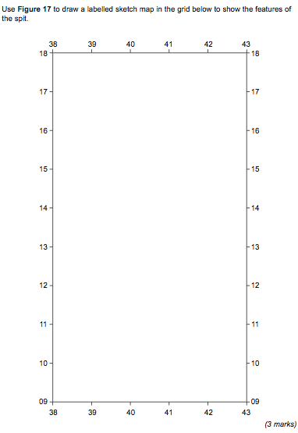
Using figure 17 to draw a labelled sketch map in the grid below to show the features of a spit
Outline should be clear and recognisable – with change in direction and variable width – 1 mark for basic outline + 1 for specific detail
Up to 2 for labels such as wider section at the end, narrow middle section, change in direction, sand and mud behind spit, sand and shingle beach along coast, marshland behind start of spit, groynes.
Figure 17

Slide 5
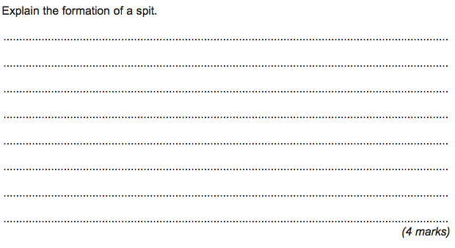
^{Level 1 (Basic) 1 – 2 marks}
^{Simple statements}
^{Order may jump about.}
^{Sequence may be incomplete.}
E.g- Deposition occurs along the coast. Longshore drift carries material along the coast.This builds a spit out to sea.
^{Level 2 (Clear) 3 – 4 marks}
Statements are developed and linked.
Sequence and formation of spit is clear.
R.G -Longshore drift carries sediment along the coast. The swash is how the material is carried up the beach and the backwash takes it back down. In this way, material is moved along the coast in the direction of the prevailing wind. If the coast changes direction, sediment continues to be dropped in the same direction. In this way, a long thin ridge of material is deposited – this is the spit. Further out to sea, the end of the spit is often curved due to waves approaching from a different direction.
Spits result from transportation and deposition along the coast.
Longshore drift carries material in the direction of the prevailing wind. When there is a break in the coast – e.g. a river mouth – or the coast changes direction, the process continues building out a long narrow ridge of material.
Often this is curved at a distance from the coast as it is affected by winds/waves from a different direction.

Slide 6
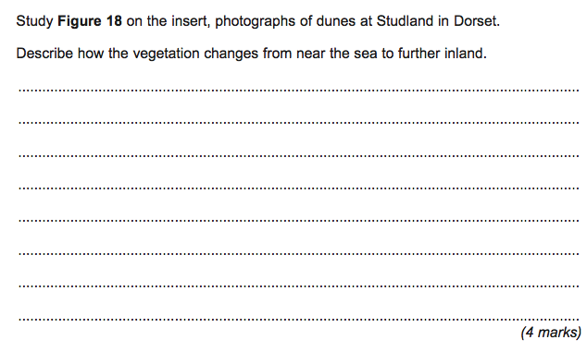
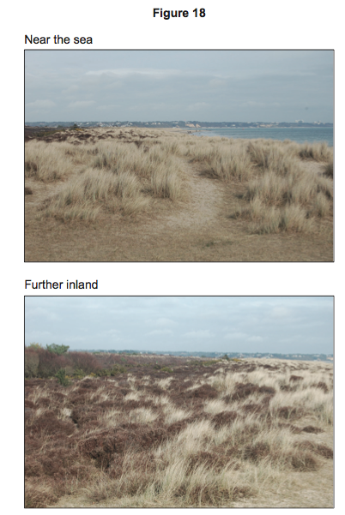
Near the beach, the vegetation is dominated by grasses – there is more than one species as seen by the different colours/leaves. (1)
^{Level 1 (basic) 1 – 2 marks}
Simple, separate listed points.
Some reference to the photograph(s).
There is a lot of sand present near the sea. Grasses are growing. Inland, there are shrubs.
One grows taller than the other (1)
Vegetation cover is incomplete – there is much sand exposed.(1)
^{Level 2 (Clear) 3 – 4 marks}
Points are developed and linked.Pictures/changes can be visualised.Specific reference to the photograph(s).
There are large gaps in the vegetation cover near the sea. Further inland, the cover is complete. The main vegetation is grass near the sea. There seem to be two types as the leaves are different colour and they are different heights. Further inland, there is much less grass and taller shrubs present.
Further from the sea, the cover is complete and there is more variety. (1)
Grass is present in smaller quantities and there are more small shrubs present.(1)

Slide 7
Level 1 (Basic) 1 – 4 marksDescribes habitat, species – may be list – like at lower end.
Statements may be in a random order.
^{Information is general.}
The dunes vary in height. They can be windy, a lot of grass grows. The area has many birds that like the vegetation present.
Level 2 (Clear) 5 – 6 marksClear description of habitat, species. Statements are linked and developed.
Addresses reasons why species are present.
^{Case study is clearly used.}
The dunes have grasses on them – especially near the sea. Marram grass is present in many areas. This can cope with the windy conditions and it has long roots to get water. Other plants can grow as the soil is made better and this allows butterflies to be present. In areas further from the sea, the vegetation is different as the conditions are more sheltered and there are more species here – of birds especially.
^{Level 3 (Detailed) 7 – 8 marks}
Detail is present in description of habitat and species.
There is a focus on explanation – with a clear understanding of why species are present.
Statements are linked and developed.
Case study is specifically used.
Near the sea, marram and lyme grass are present in many areas.
These can cope with the windy conditions – marram can fold its leaves and it has long roots to get water. Other plants, such as sea spurge, can grow as the soil is made better and this allows butterflies to be present. In areas further from the sea, the vegetation is different as the conditions are more sheltered and there are more species here – of different as the conditions are more sheltered and there is more protection. Areas of fresh water marsh can occur in the lower lying areas between the dune ridges. Here the plants are different as there is shelter and water is readily available.Reeds and yellow iris are found here and also water voles in some areas.

