Slide 1
AQA A
Interactive examination practice
June 2011

Slide 2
Instructions
Manufacturing [1 mk]
1 -2 mks – Little attempt, poor examples, no structure, little terminology
There must be reference to location, max 1 for a list rather than a sense of place.
If you see a blue box, this gives you the answer to a question and the marks for that answer.
If you see an answer in a purple box that information will be linked to advice on how to gain top marks in your answer.
Bangladesh [1 mk]
6 -8 mks – Detailed, Structured answer, Specific examples, good use of terminology
If you see an answer with a red box this means a mark can be obtained by including an example/name or case study
If you see this on a question then the question is levelled and greater marks are obtained as explained above

Slide 3
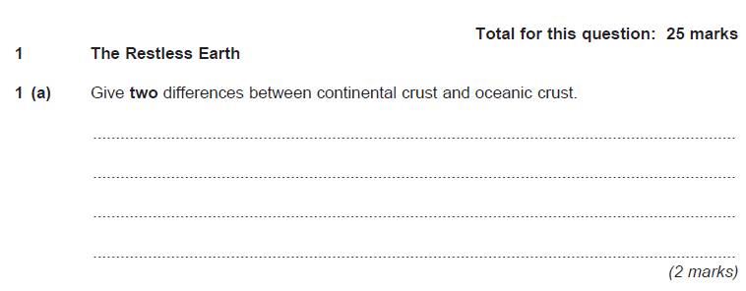
Continental crust is lighter than oceanic crust/less dense [ 1mk ]
Continental is older than oceanic crust [ 1mk ]
Continental cannot be renewed and/or destroyed/ subduct. [ 1mk ]
Continental crust is thicker[ 1mk ]

Slide 4
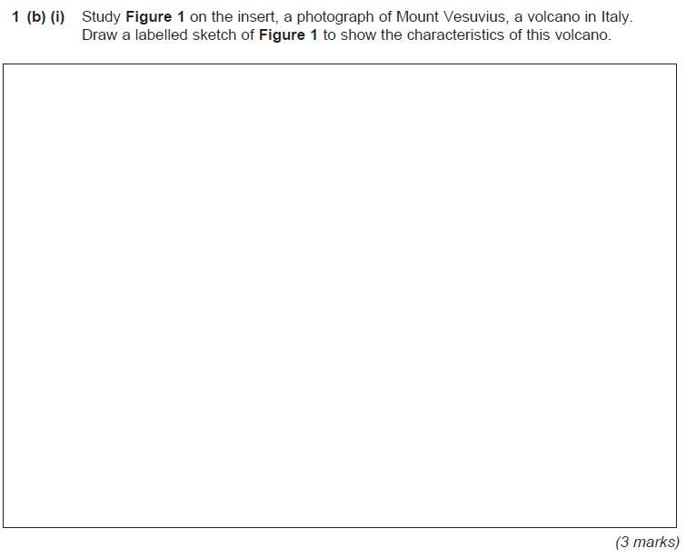
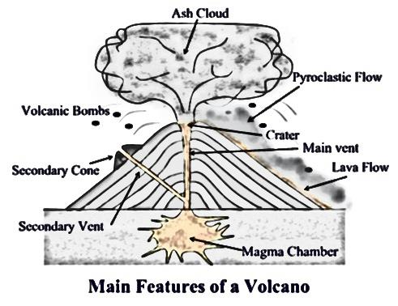
Drawing a cone shape sketch [ 1mk ]
Ash cloud [ 1mk ]
Crater
[ 1mk ]
Pyroclastic flow [ 1mk ]
Volcanic bombs [ 1mk ]
Main vent [ 1mk ]
Lava flow [ 1mk ]
Secondary vent[ 1mk ]
Magma chamber[ 1mk ]

Slide 5
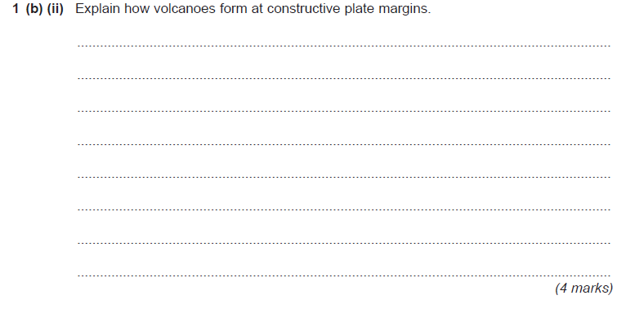
As they pull apart, a ‘gap’ is created between the plates. [ 1mk ]
Lava builds up in the hole. [ 1mk ]
Magma rising up out of the mantle to plug the gap and make the crust[ 1mk ]
Layers of lava solidify and build up to create volcanoes [ 1mk ]
Often occurs in oceans [ 1mk ]

Slide 6
Large scale/ a mega (colossal) eruption [ 1mk ]
1000 cubic km of material is erupted [ 1mk ]
Tends to be sunken [ 1mk ]
Flat areas. [ 1mk ]
May indicate size/shape by contrasting with a volcano. [ 1mk ]
Mark for size, 1 Mark for shape.

Slide 7
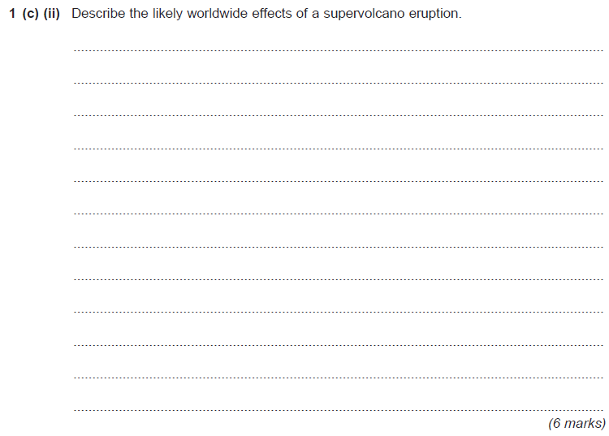
Large ash cloud rising 40 – 50km into atmosphere [ 1mk ]
Destruction of 10000 square km of land [ 1mk ]
Ash 15cm think covering buildings within 10000km[ 1mk ]
Flights suspended [ 1mk ]
Livestock and farmland affected[ 1mk ]
Crops would Fail [ 1mk ]
40% of population could face starvation [ 1mk ]
The UK would see the arrival of the ash 5 days after the eruption [ 1mk ]
Temperatures would fall between 12 and 15 degrees [ 1mk ]
Parts of Europe and America and Asia would see constant snow cover for 3 years [ 1mk ]

Slide 8
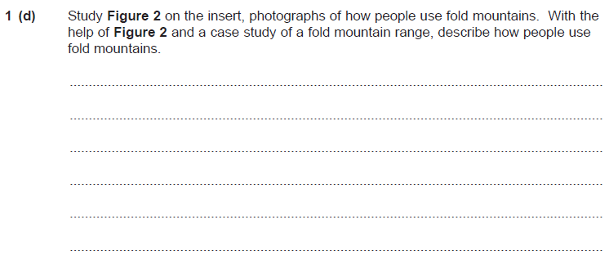
Must have a case study – Himalayas or Alps – 2 marks max without case study
Farming [ 1mk ] + explanation [ 1mk]
Hydro electric power / Dams [ 1mk ] + explanation [ 1mk]
Mining [ 1mk ] + explanation [ 1mk]
1 -2 mks – Little attempt, poor examples, no structure, little terminology
Tourism [ 1mk ] + explanation [ 1mk]
6 -8 mks – Detailed, Structured answer, Specific examples, good use of terminology

