Slide 1
AQA A
Interactive examination practice
June 2011

Slide 2
Instructions
Manufacturing [1 mk]
1 -2 mks – Little attempt, poor examples, no structure, little terminology
There must be reference to location, max 1 for a list rather than a sense of place.
If you see a blue box, this gives you the answer to a question and the marks for that answer.
If you see an answer in a purple box that information will be linked to advice on how to gain top marks in your answer.
Bangladesh [1 mk]
6 -8 mks – Detailed, Structured answer, Specific examples, good use of terminology
If you see an answer with a red box this means a mark can be obtained by including an example/name or case study
If you see this on a question then the question is levelled and greater marks are obtained as explained above

Slide 3
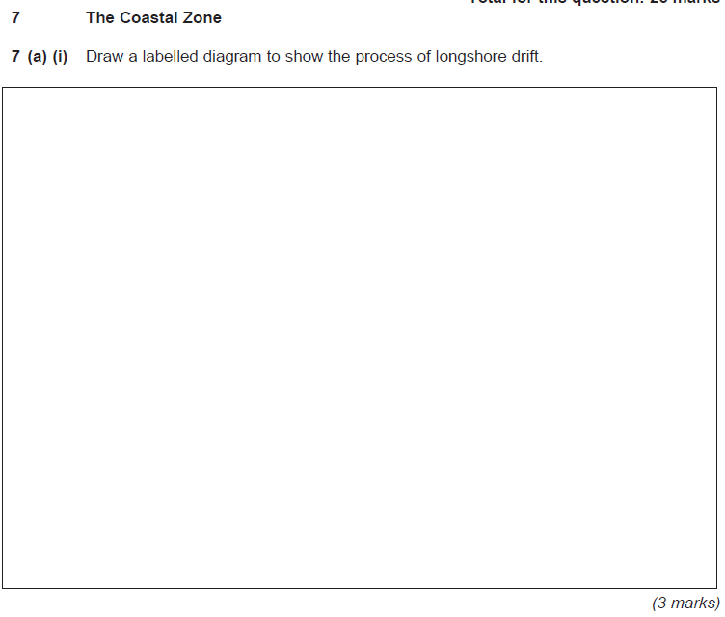
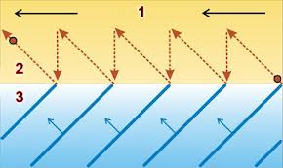
Long shore drift labelled and drawn [1mk]
Swash labelled and drawn [1mk]
Backwash labelled and drawn [1mk]
Sketch [1mk]

Slide 4
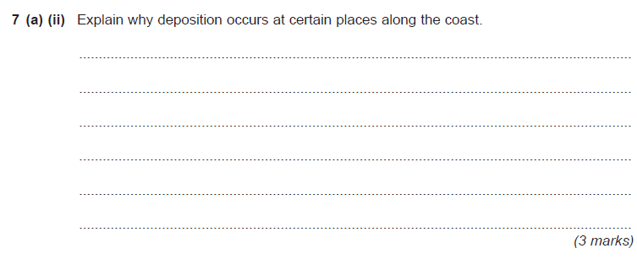
Low energy waves [1mk] + explanation [1mk]
Areas of high coastal erosion [1mk]
Sheltered bays [1mk]

Slide 5
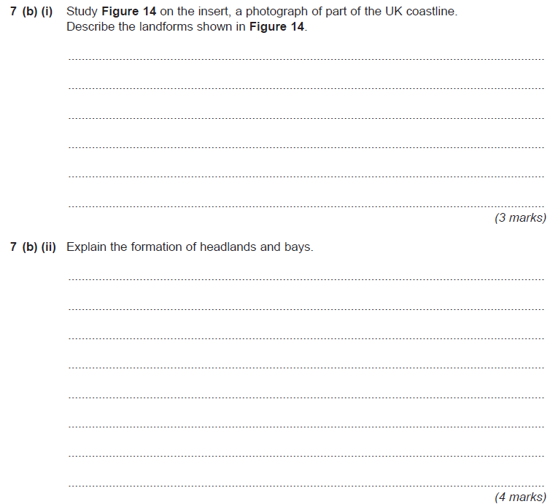
Headland [ 1mk ] + description [1mk]
Cave [ 1mk ] + description [1mk]
Wave cut platform [ 1mk ] + description [1mk]
Vertical cliffs [ 1mk ]
Hard and soft rock[ 1mk ]
Hard rock erodes quicker than soft rock [ 1mk ]
Softer rock is eroded more easily through abrasion, hydraulic action, attrition and solution [ 2mk ]

Slide 6
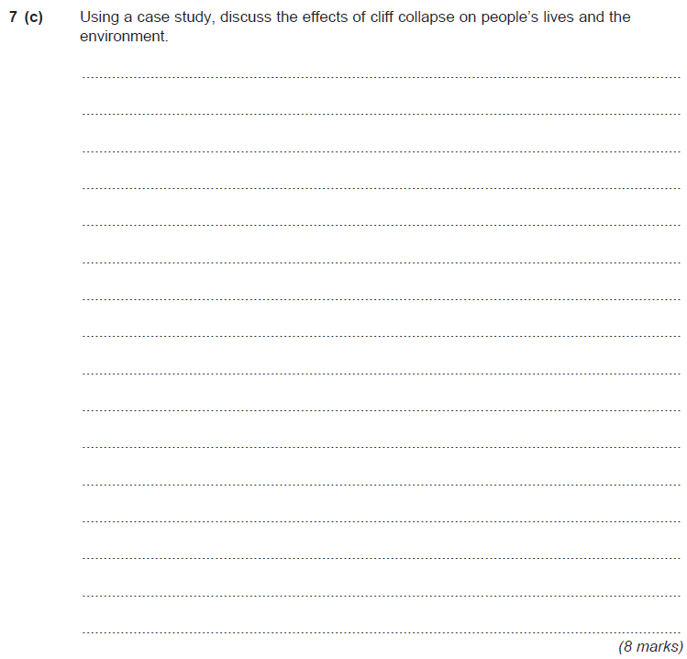
Mappleton
Scarborough
Housing threatened [ 1mk ]
Increased erosion rates effects habitats [ 1mk ]
Businesses threatened [ 1mk ]
Access threatened [ 1mk ]
Impact on tourism [ 1mk ]
Stress [ 1mk ]
Difficult to sell housing [ 1mk ]
Caravan sites have to close [ 1mk ]

