Slide 1
AQA A Interactive examination practice
Unit 1 / Higher

Slide 2
Instructions
Manufacturing [1 mk]
1 -2 mks – Little attempt, poor examples, no structure, little terminology
There must be reference to location, to gain top marks for that question.
If you see a blue box, this gives you the answer to a question and the marks for that answer.
If you see an answer in a purple box that information will be linked to advice on how to gain top marks in your answer.
Bangladesh [1 mk]
6 -8 mks – Detailed, Structured answer, Specific examples, good use of terminology
If you see an answer with a red box this means a mark can be obtained by including an example/name or case study
If you see this on a question then the question is levelled and greater marks are obtained as explained above

Slide 3
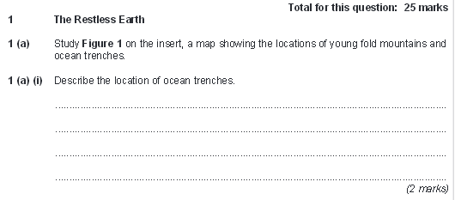
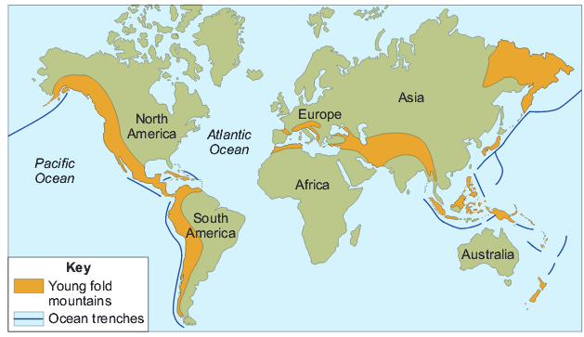
Often ocean trenches seem to be near to fold mountains + location (1mk)
Ocean trenches occur most on the edge of the Pacific Ocean. (1mk)
There must be reference to location, max 1 for a list rather than a sense of place.

Slide 4
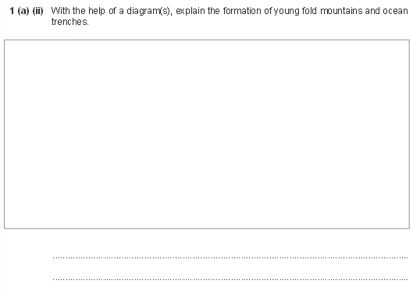
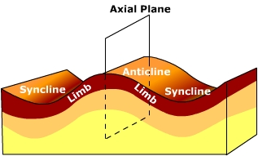
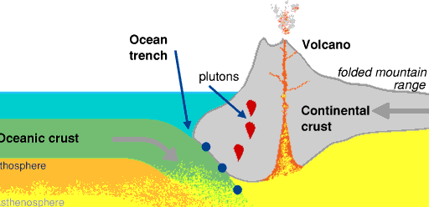
Diagram with correct labels/ annotation (1mk)
Diagram with correct labels/ annotation (1mk)
Reference to destructive plate margins (1mk)
1-2mk
7-8mk
Reference to a subduction to explain ocean trenches (1mk)
Oceanic crust is denser than continental crust (1mk)
Oceanic crust sinks beneath the lighter continental crust that creating a deep section of the ocean called an oceanic trench. (1mk)
Continental crust is squashed up as it moves towards the oceanic plate. (1mk)
Plates move together and crumple producing (anticlines and synclines of)
fold mountains. (1mk)

Slide 5
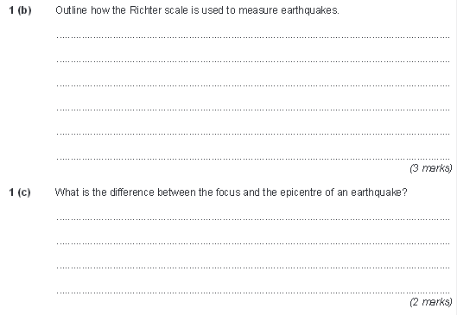
Richter Scale uses information collected by seismometers (1mk)
Seismometers record the strength of shock waves and amount of movement (1mk)
A seismogram shows a ‘line graph’ of the waves which is used to assign a
number on the Richter Scale between 0/1 and notionally 10 (1mk)
The scale is logarithmic so that an increase of 1 represents a 10 fold increase and of 2 a hundred times etc (2mk)
Focus is within the earth’s crust where the earthquake begins below the ground (2mk)

Slide 6
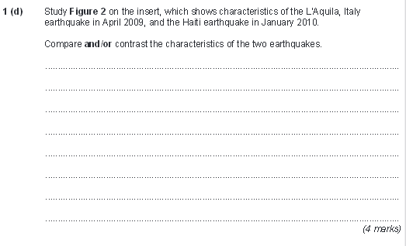
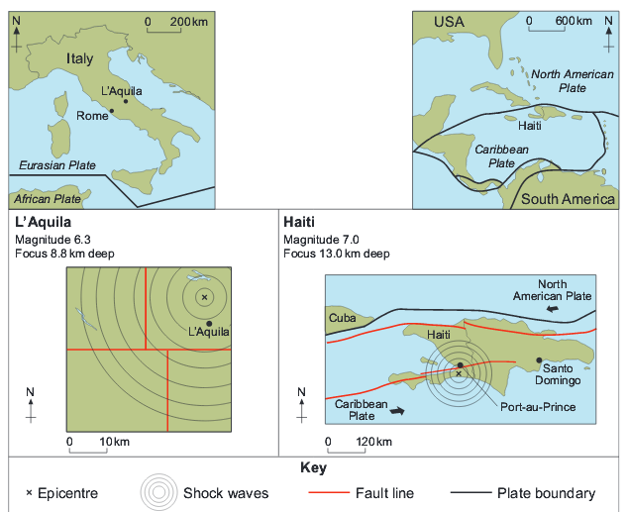
Depth of the focus is similar – approx 9 – 13 km (1 mk without figures , 2mk with figures)
The magnitude was different, the Haiti one being 0.7 stronger – 7.0 as opposed to 6.3 (1 mk without figures , 2mk with figures)
The Haiti earthquake affected much of the country only part of Italy was affected (1mk)
The shock waves seem to cover a wider area in Haiti, suggesting greater impact. (1mk)

Slide 7
Haiti
Kobe
Chile
Max marks = 2 without case study
Basic answers
Lots of people die in earthquakes more in poor countries (1mk)
Buildings collapse and people are buried. (1mk)
They have nowhere to live. (1mk)
Roads and bridges fall. (1mk)
1-2mk
5-6mk
Extended answers
Lots more people die in poorer countries in earthquakes. (2mks if figures are included)
Many buildings collapsed, fire risk , many burning buildings. (2mks for explanation)
Damage was less in richer countries than in poor countries. (2mks if figures are included)

