Slide 1
Exam Questions and Answers
Unit 1/ Restless earth

Slide 2
Instructions
Manufacturing [1 mk]
1 -2 mks – Little attempt, poor examples, no structure, little terminology, description only
If you see a blue box, this gives you the answer to a question and the marks for that answer.
Bangladesh [1 mk]
If you see an answer with a red box this means a mark can be obtained by including an example/name or case study
5 -6 mks – Detailed, Structured answer, Specific examples, good use of terminology, detailed explanation
If you see this on a question then the question is levelled and greater marks are obtained as explained above

Slide 3
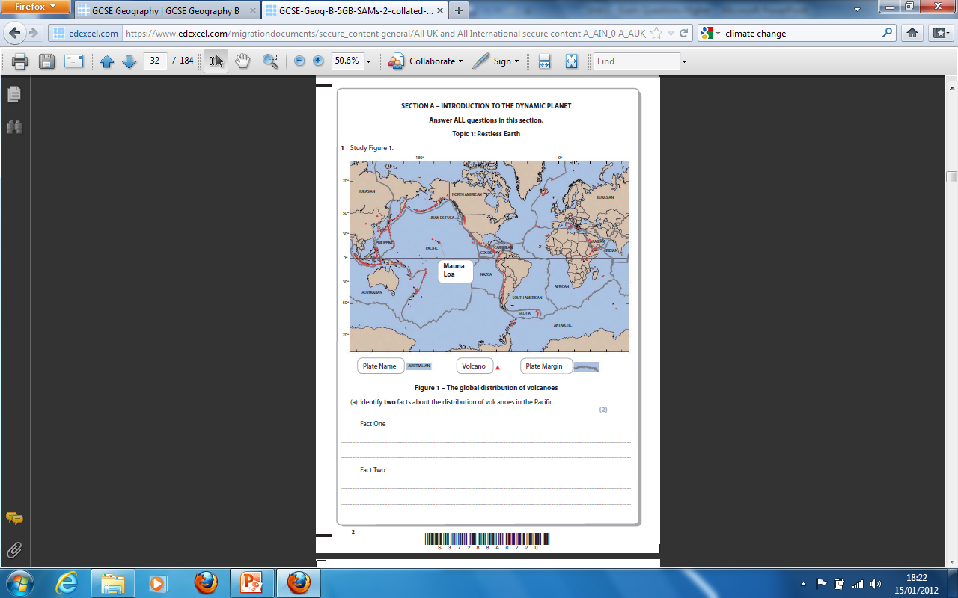
Along plate boundaries [1MK]
Clustered together[1MK]
On the edge of plates [1MK]
Many or few in a named location[1MK]

Slide 4
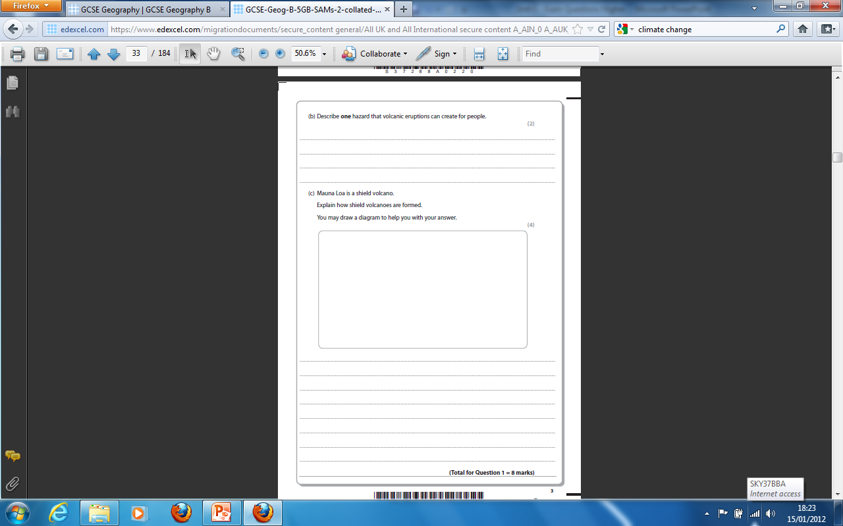
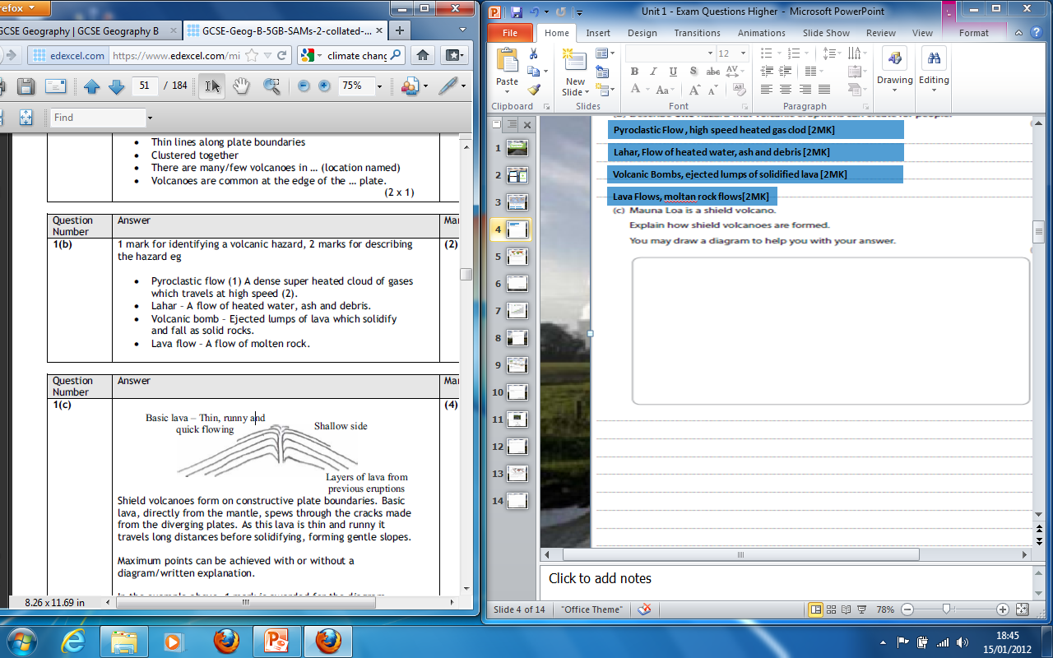
Pyroclastic Flow , high speed heated gas clod [2MK]
Lahar, Flow of heated water, ash and debris [2MK]
Volcanic Bombs, ejected lumps of solidified lava [2MK]
Lava Flows, moltan rock flows[2MK]
1 -2 mks – Little attempt, poor examples, no structure, little terminology, description only
Drawing similar to the diagram above[1MK]
Labels/annotation [1MK]
Constructive plate boundaries [1MK]
Lava is thin and runny travelling long distances [1MK]
Forms low gentle slopes [1MK]
3-4 mks – Detailed, Structured answer, Specific examples, good use of terminology, detailed explanation

Slide 5
Subduction Zone [ 1mk ]
Trench Ocean [ 1mk ]
Destructive boundary [ 1mk ]
Fold Mountains [ 1mk ]
Mountains [ 1mk ]
Volcano [ 1mk ]
Continental plate [ 1mk ]
Improving monitoring/
prediction [ 1mk ]
Earthquake drills [ 1mk ]
Action plans [ 1mk ]
1 –mrk – Identifying
Preparation strategy
Reinforcing transport connections
[ 1mk ]
Evacuation plans
[ 1mk ]
Stock piling food, tents
and medical supplies
[ 1mk ]
Strengthening buildings e.g. steel frames [ 1m ]
2 mks – Describing the impact/strategy

Slide 6
Kobe, Japan [ 1 mk ]
1 -2 mks – Little attempt, poor examples, no structure, little terminology
Injury or death [ 1mk ]
Buildings collapse [ 1mk ]
Roads damaged [ 1mk ]
Landslides [ 1mk ]
Bridges weakened [ 1mk ]
3-4 mks – Detailed, Structured answer, Specific examples, good use of terminology
Falling glass from tower blocks [ 1mk ]
Explosions from broken gas pipes [ 1mk ]
Food shortages [ 1mk ]

