Slide 1
Structuring examination questions
Understand how to structure examination questions to gain L3 answers on
6-8mk questions
Success Criteria
Level 1 (Basic answers) 1 – 4 marks. (E-D)
Level 2 (Clear answers) 5 – 6 marks (C-B)
Level 3 (Detailed answers ) 7 – 8 marks (A-A*)

Slide 2
Option 1
Describe how the effects of an earthquake in a richer area of the world are different from an earthquake in a poorer area of the world. (8mks)
Introduction
Re-write the question using the key terms and case study name(s)
Point/ comment using case study 1
Main section
Point/ comment using case study 1
Point/ comment using case study 1
Evaluation/ links to the question
Point/ comment using case study 2
Point/ comment using case study 2
Point/ comment using case study 2
Evaluation/ links to the question
Conclusion
Summarise key

Slide 3
Option 2
Describe how the effects of an earthquake in a richer area of the world are different from an earthquake in a poorer area of the world. (8mks)
Introduction
Re-write the question using the key terms and case study name(s)
Point/ comment using case study 1
Main section
Point/ comment using case study 2
Evaluation/ links to the question)
Point/ comment using case study 1
Point/ comment using case study 2
Evaluation/ links to the question)
Point/ comment using case study 1
Point/ comment using case study 2
Evaluation/ links to the question)
Conclusion
Summarise key themes

Slide 4
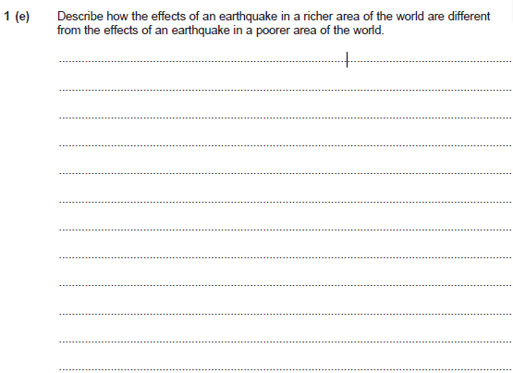
Introduction
There are different effects which have an impact on richer and poorer countries as a result of an earthquake. The two countries I will study are Haiti and Chile.
500 killed and 12,000 injured
Main section
500,000 homes damaged
Bridges , roads and hospitals were destroyed (Infrastructure)
This evidence shows that the impact of an earthquake on a richer country was relatively low despite the magnitude.
200,00 killed and 300,000 injured
100,00 destroyed and 200,000 homes damaged, 1.3 million homeless
Roads blocked, 8 hospitals destroyed, government buildings collapsed (Infrastructure)
Compared to Chile, Haiti suffered a smaller earthquake yet had significantly more damage.
Conclusion
It is clear that richer countries such as Chile are less effected by earthquakes than poorer countries. Haiti had significantly more deaths, injuries and damage to infrastructure than Chile.
Level 3 – 7-8 marks (A-A*)
Effects are clearly described
Statements are linked
Differences are clear
There are references to case studies

