Slide 1
De Aston School Geography Department
Reveal and revise diagrams
Memorise a diagram and hide it to test how much you remember…
Topic 1,3 & 7

Slide 2
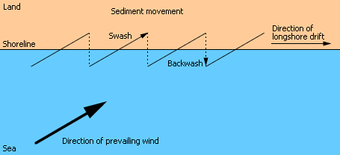
Diagram 1
Long shore drift. Click to cover and click to reveal

Slide 3
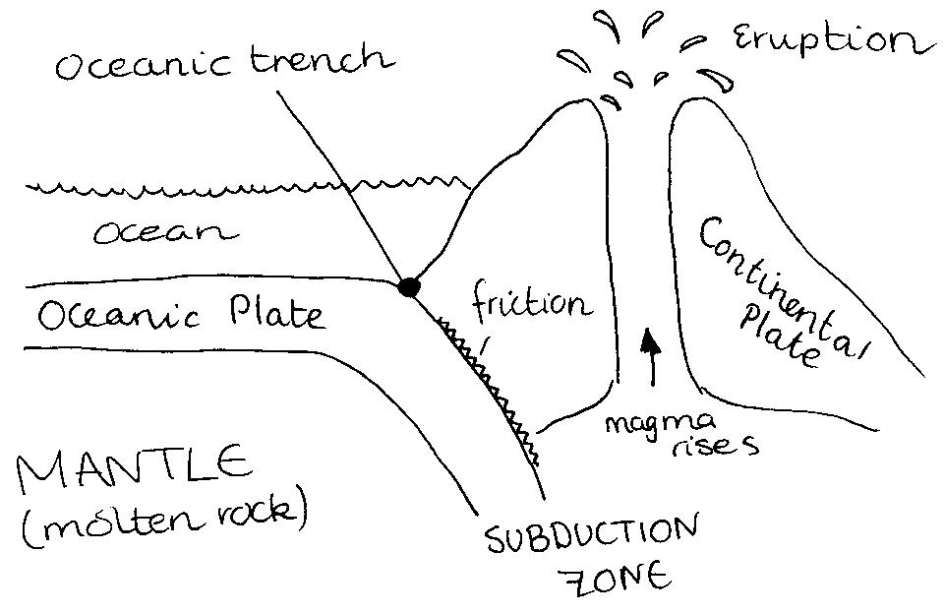
Diagram 2
A destructive plate boundary. Click to cover and click to reveal

Slide 4
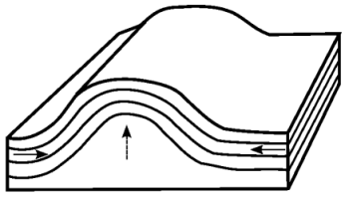
Diagram 3
A fold mountain. Click to cover and click to reveal
Pressure exerted from moving plates
Rocks fold under heat and pressure
Pressure exerted from moving plates

Slide 5
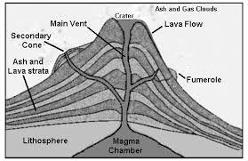
Diagram 4
A composite volcano. Click to cover and click to reveal.

Slide 6
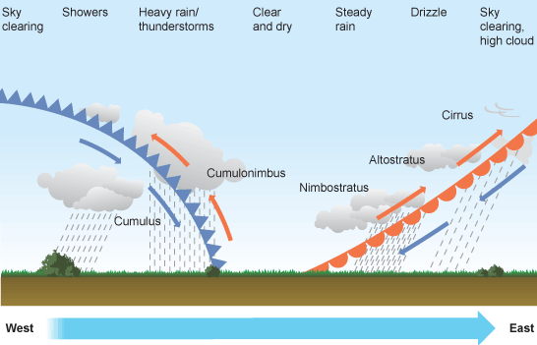
Diagram 5
A cross section of a depression. Click to cover and click to reveal.

Slide 7
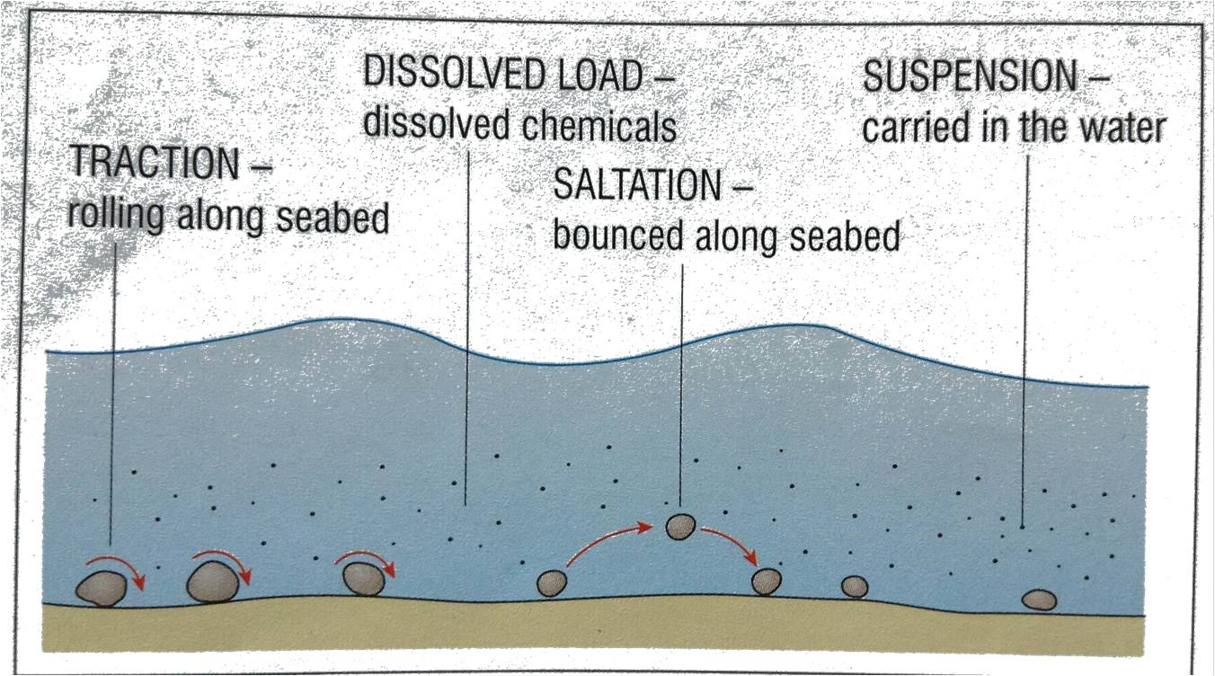
Diagram 6
Transport processes. Click to cover and click to reveal.

Slide 8
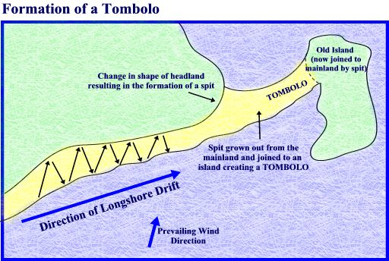
Diagram 7
A Tombolo. Click to cover and click to reveal.

Slide 9
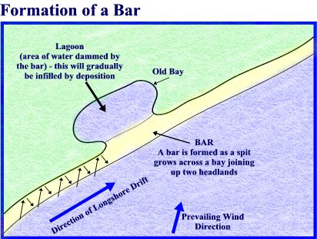
Diagram 8
A Bar. Click to cover and click to reveal.

Slide 10
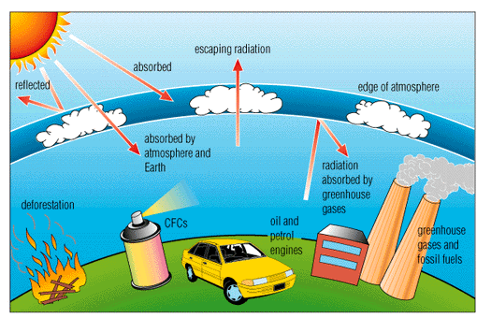
Diagram 9
The greenhouse effect. Click to cover and click to reveal.

Slide 11
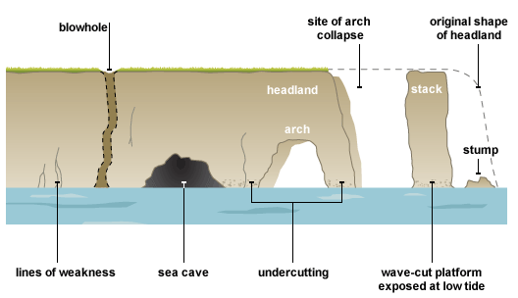
Diagram 10
Stack, cave arch, stump. Click to cover and click to reveal.

