Slide 1
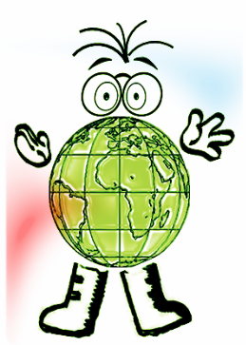
AQA A Interactive examination practice
Unit 1 / Higher
Test your self on each of the exam questions and reveal the answers to see if your correct.

Slide 2
Instructions
Manufacturing [1 mk]
1 -2 mks – Little attempt, poor examples, no structure, little terminology
There must be reference to location, max 1 for a list rather than a sense of place.
If you see a blue box, this gives you the answer to a question and the marks for that answer.
If you see an answer in a purple box that information will be linked to advice on how to gain top marks in your answer.
Bangladesh [1 mk]
6 -8 mks – Detailed, Structured answer, Specific examples, good use of terminology
If you see an answer with a red box this means a mark can be obtained by including an example/name or case study
If you see this on a question then the question is levelled and greater marks are obtained as explained above

Slide 3
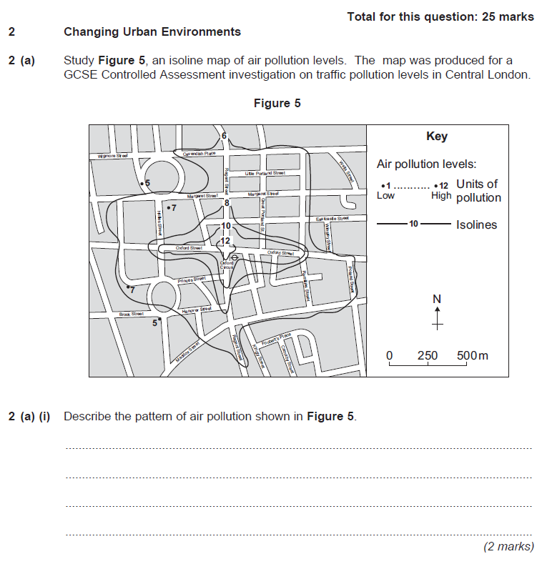
A decrease outwards from Oxford Circus/centre. (1mk)
Air pollution is higher along the roads.(1mk)
Steep drop in pollution levels near the centre/middle, some gentle further away(1mk)
High pollution levels in along Oxford Street/Regent Street (1mk)

Slide 4
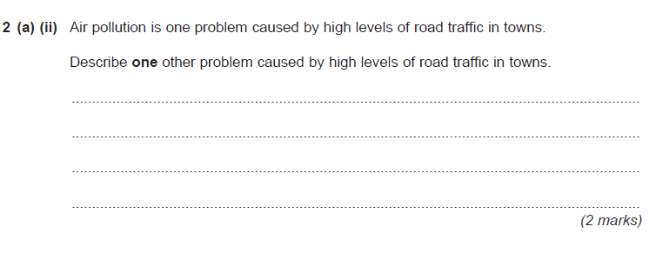
Accidents due to people trying to cross the road (1mk)
Time wasting during journeys to work because of traffic jams(1mk)
Road-rage (1mk)
Noise pollution (1mk)

Slide 5
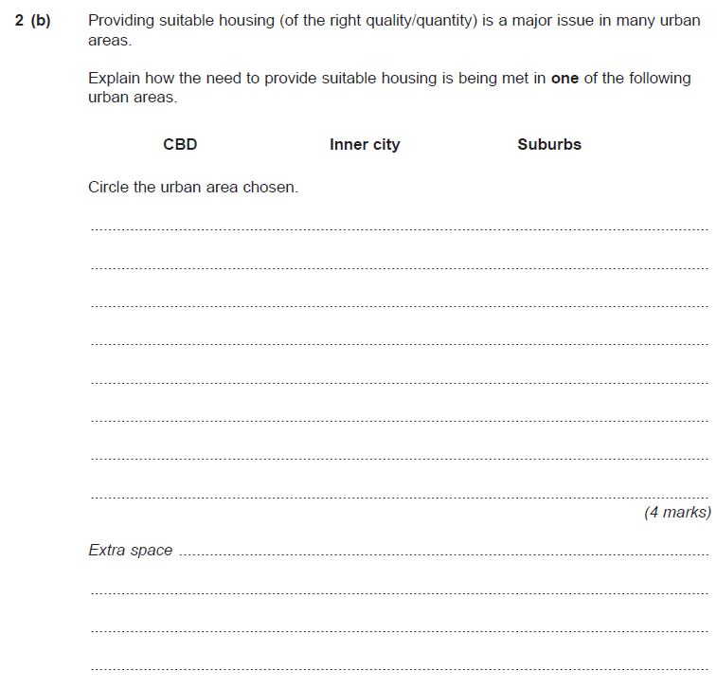
Build flats over shops(1mk)
Modernising terraced housing. (1mk)
Building new estates (1mk)
Building Flats (1mk)
Building on Green Belts (1mk)
Putting in modern facilities (1mk)
Updating and renovating terraced housing by putting in modern facilities(2mks)
Building more housing (1mk)
Gentrification (1mk)
Building more housing estates leading to urban sprawl on the Green Belt. (2mk)
Building more housing. (1mk)
Demolishing slum properties and replacing with modern town housing. (2mks)
Turning empty spaces above shops into residential accommodation. (2mk)
Building a mix of different types of properties so as to provide for different family sizes. (2mk)
Buildingapartment blocks to accommodate young professionals who work in CBDs.(2mks)
Building student accommodation in disused property in CBD, which were formally large outdated residences. ( 2mk)
Adapting former industrial buildings and warehouses into modern apartments. (2mks)

Slide 6
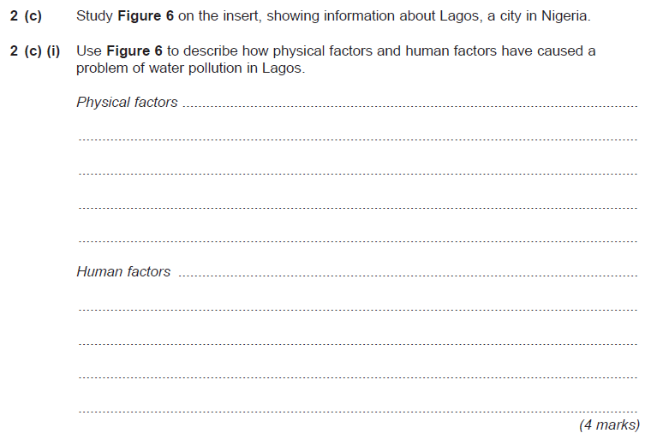
Click for fig 6
Physical - The low lying nature of the site (1mk) and the many creeks and islands means that the city is regularly flooded by the sea and so the water supply gets polluted. (2mks with detail)
Human – The rapid growth of squatter settlements without any sewerage system (1mk) leads to pollution of the water supply.
(2mk with detail)

Slide 7
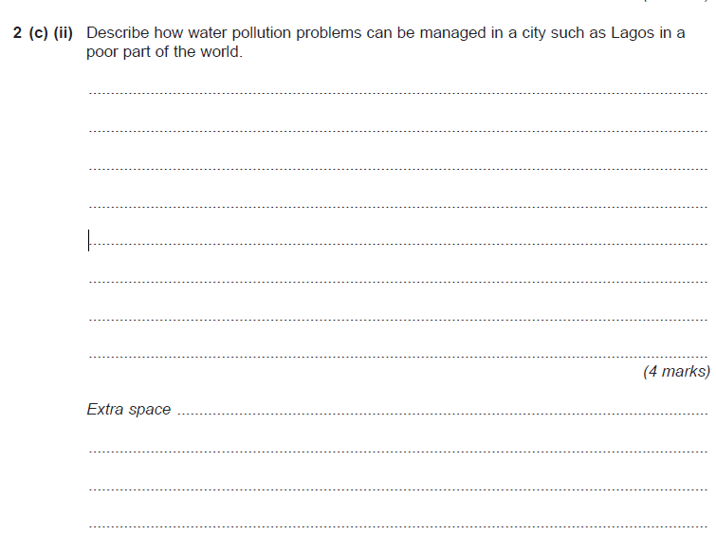
Level 1 (Basic) 1 mark - Simple statements
Put in piped water system (1mk)
Improve sewerage infrastructure (1mk)
Flood defences (1mk)
Relevant education (1mk)
Level 2 (Clear) 3-4 marks - Linked statements
Improve sewerage infrastructure to improve/reduce the problem of water pollution( 2mk)
Improve sewerage infrastructure so that one does not contaminate the other (1mk)
Put in piped water system (1mk) create a safe piped water and sewerage system (2mks)

Slide 8
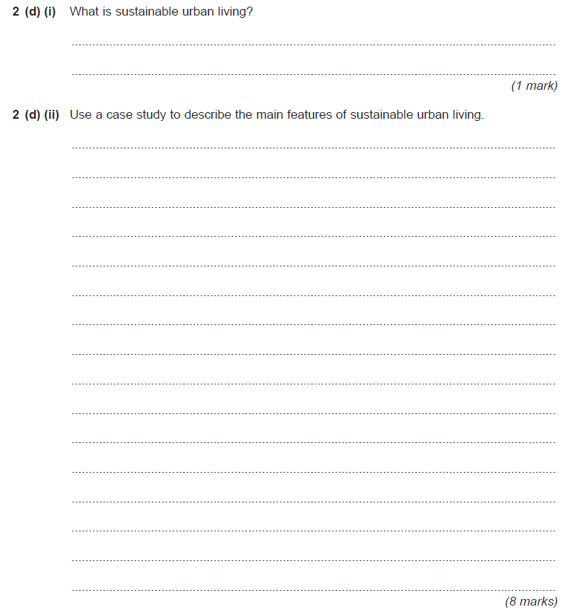
Urban living, which is not wasteful and does not pollute the environment.
Haiti
Kobe
Chili
1-2mk
7-8mk
Level 1 (Basic) 1-4 marks - Simple statements without any reference to any case study.
Level 2 (Clear) 5-6 marks - Linked statements with at least the name of a case study.
Level 3 (Detailed) 7-8 marks - Detailed use of case study exemplification.
Bedzed
Curitiba
They use renewable energy (1mk) + explanation (2mks)
Public transport (1mk) + explanation (2mks)
Plenty of green spaces (1mk) + explanation (2mks)
Recycling (1mk) + explanation (2mks)
They use renewable energy (1mk) + explanation (2mks)
Public transport (1mk) + explanation (2mks)
Water recycling (1mk) + explanation (2mks)
Car sharing schemes (1mk) + explanation (2mks)
Other description (1mk) + explanation (2mks)

Slide 9
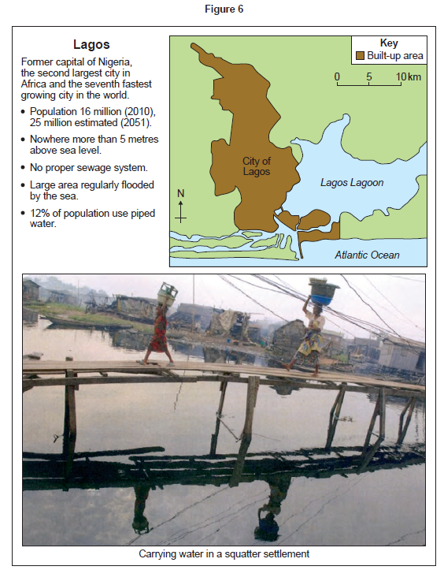
Return to Question

