Slide 1
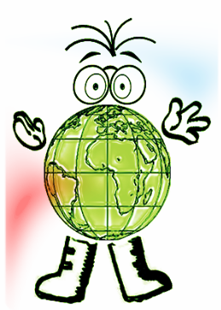
De Aston School Geography Department
Terminology test
Test your self on each of the geographical terms shown and reveal the answer to see if your correct.
Topic 3 – Weather hazards

Slide 2
What does this geographical term mean?
Click to reveal answer and the next geographical term.
Climate
Average weather measured over thirty plus years
Weather
Short term day to day changes
Latitude
The further away from the equator you are the cooler it gets.
Continental
Weather not influenced by the sea
Altitude
Height above sea level. For every 100 metres high up you go the temperature changes by one degree.
Pressure
Defined in weather by high pressure and low pressure
Prevailing wind
The direction from which the main winds blow (UK – Southwest)

Slide 3
What does this geographical term mean?
Click to reveal answer and the next geographical term.
Relief rainfall
The development of rain by air rising over hills or mountains
Convectional rainfall
The development of rain through rising air
Frontal rainfall
The development of rain by a warm or cold fronts. (depression)
Depression
Low pressure or cyclonic weather giving cloudy wet and windy weather
Anticyclone
High pressure giving stable and prolonged weather. In summer this can bring heat waves and in winter this can introduce very cold conditions.
Synoptic chart
A weather map with symbols representing different types of weather
Cloud cover
Measured in Oktas, this is the amount of cloud in the sky

Slide 4
What does this geographical term mean?
Click to reveal answer and the next geographical term.
Pressure
Measured in millibars this is weight of the atmosphere pressing down on the earths surface.
Precipitation
Wind, hail, sleet or snow
Temperature
Measured in Celsius
Wind speed
Measured in mph, using the Beaufort scale 37-46mph is a gale force wind and 74mph is hurricane category 1 .
Wind direction
The direction the wind is blowing from.
Extreme weather
Unexpected, severe and/or uncharacteristic weather conditions
Heat wave
Prolonged period of weather without rainfall

Slide 5
What does this geographical term mean?
Click to reveal answer and the next geographical term.
Hurricane, typhoon or cyclone
A tropical revolving storm event with winds above 74mph
Coriolis force
The force that helps the formation of hurricanes.
The eye of the storm
The calm centre of a hurricane
Storm surge
The rising sea level during storm events caused through extreme low pressure.
Primary impact
Immediate effects of a weather event
Secondary impact
Longer term effects of a weather event
Response
How a country copes with an extreme weather event
Weather Forecasting
Predicting the weather to a percentage accuracy

