Slide 1
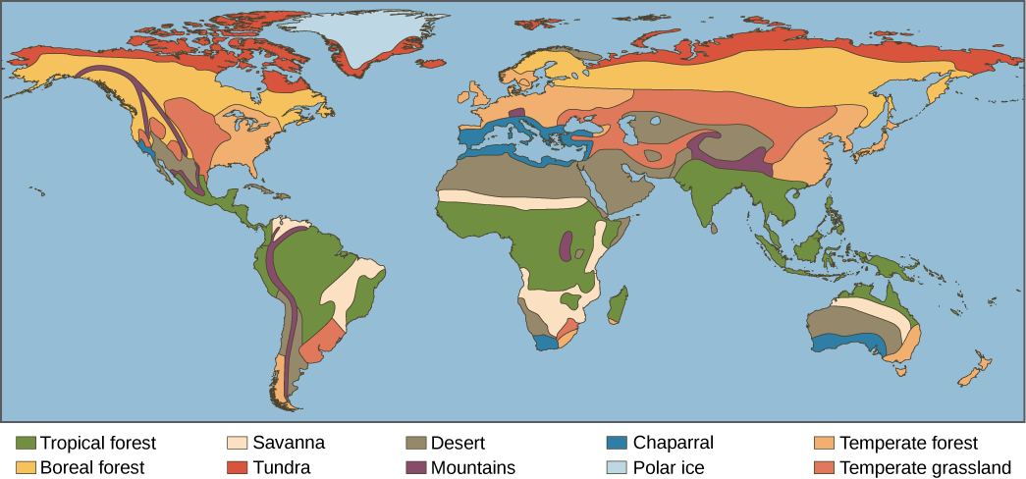
Unit 1/ Section B/ The Living World
ECONOMIC
SOCIAL
ENVIRONMENTAL

Slide 2
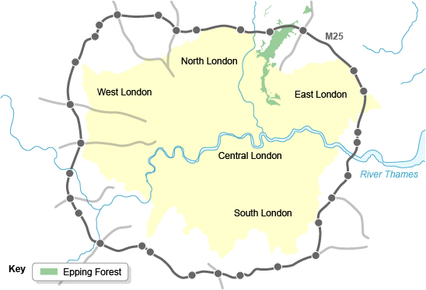
Epping Forest:
ECONOMIC
SOCIAL
ENVIRONMENTAL
Management:
City of London Corporation overall management.
Site of Special Scientific Interest (SSSI)
Balance conservation with open to the public.
Management Techniques:
Pollarding: encourages new growth and maintains the trees for future generations.
Sustainable management.
Dead wood left to rot.
Encourages fungi and wildlife.
Recreational areas marked out.
Background Information:
Epping Forest is a deciduous forest.
Located in north-east London.
Uses:
Wildlife.
Historic landscape.
Walking.
Horse-riding.
Cycling.
Fishing.
60 football pitches.
18 hole golf course.

Slide 3
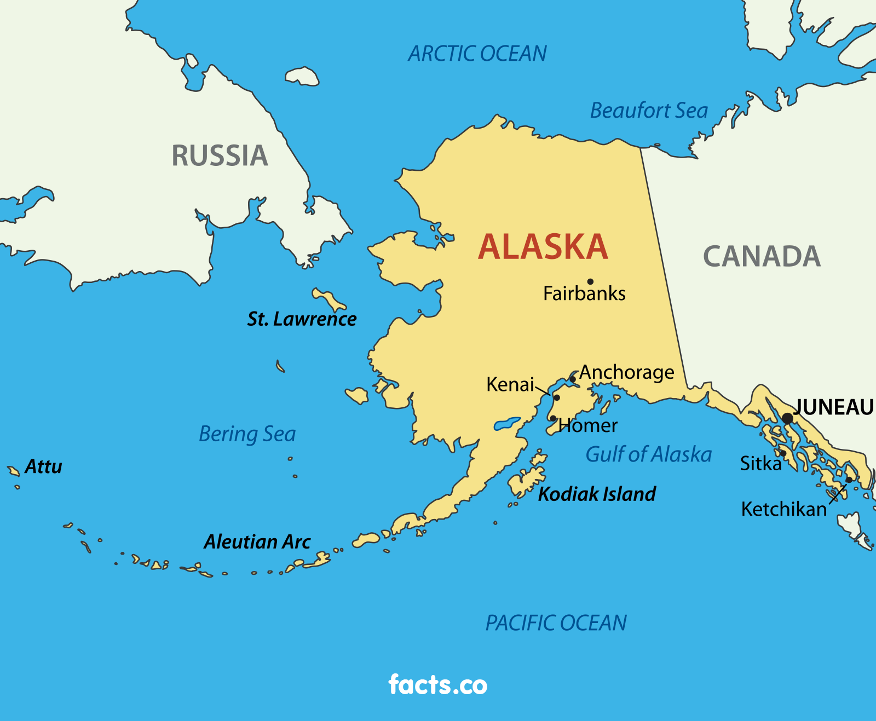
Alaska – Arctic circle:
ECONOMIC
SOCIAL
ENVIRONMENTAL
Energy:
Hydro-electric energy (HEP)-50 HEP plants, one fifth of their electricity.
Geothermal-Chena Hot Springs resort powered entirely by geothermal power.
Challenges of Alaska:
Solifluction: soils active layer starts to flow downhill covering highways.
Permafrost: off road travel cannot take place during summer.
Buildings: high pitched roofs, triple glazing, heat from buildings melt ice causing subsidence, buildings raised on piles.
Infrastructure: roads built on gravel pads, sewage, water and gas cannot be buried so carried by utility corridors. Airport runways painted white to reflect sunlight.
Alaskan oil:
The pipeline:
Costs (negatives)
Negative social impacts.
Pollution.
Endangers habitats.
Benefits (Positives)
Economic gains.
Better schools and healthcare for those living within the oil-drilling communities.
Alternative Energy Resource.
Increases National Defence.
Future development of offshore oil:
ANWR (Arctic National Wildlife Refuge): Home to rare wildlife e.g. polar bears, wolverines and snow geese. 6-16 billion barrels lie beneath ANWR. 2005, US Senate voted to block proposals to drill.
Kaktovik and Barrow: No drilling off coast. Home to bowhead whales and Inupiat residents.
Background Information:
Alaska, northwest of Canada, is the largest and most sparsely populated U.S. state.
Opportunities of Alaska
Fishing Industry: Commercial:
Since 1870 one in ten Alaskans employed.
Biggest salmon, crab and whitefish fisheries.
78,500 jobs.
US$6 billion to state economy.
Subsistence:
Native American communities dependant.
Fish provide food, oil and bones.
Mineral Extraction: Gold mines:
One fifth of the states mining wealth from gold.
Mines need to be managed carefully environmental impacts.
Humans and ecosystems can be harmed.
Toxic chemicals used.
Tourism:
1-2 million summer visitors a year.
Seasonal poorly paid work.
Fishing, wildlife, whale watching, kayaking, hiking, skiing, rock climbing and sightseeing.
60% cruise ship passengers.
National parks, preserves, refuges, monuments and historical sites.

Slide 4
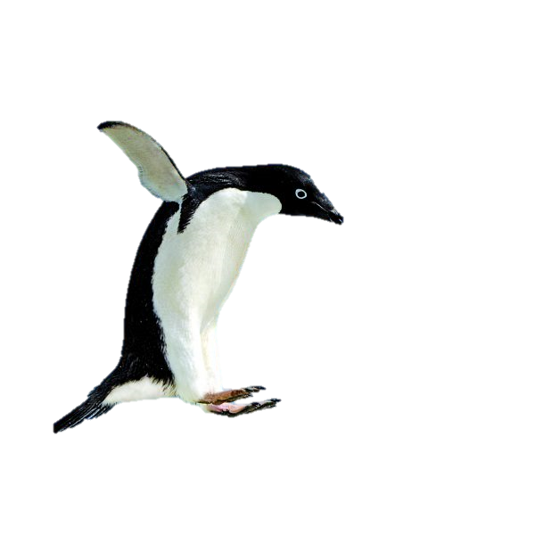
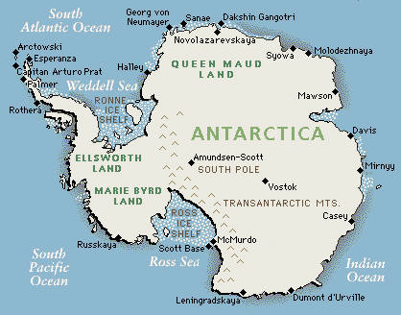
Antarctica:
ECONOMIC
SOCIAL
ENVIRONMENTAL
Tourist Activities:
Fly over the ice.
Climb rock and ice faces
Cruise inlets in small boats
Visit the scientific research stations.
Scuba dive under the ice.
Hike.
Kayak.
Explore shallow sea beds in underwater vehicles.
Conservation Agencies:
The IAATO (International Association of Antarctica Tour Operators)
Limit tourist activity and the impact on the environment.
Using technology to monitor the Antarctic:
Scientific research takes place to monitor climate, ice movement, animals, plants, the sea and the Earths magnetic field.
Managing the Antarctic:
Antarctic Treaty 1961.
1998 Protocol on Environmental; Protection to the Antarctic Treaty.
No activities until impacts assessed and minimised.
Strict guidelines.
£10,000 per person Antarctic excursion.
Background Information:
Southernmost continent.
Site of the South Pole.
Low population density.
The Antarctic Treaty:
Signed by 50 countries.
Attempt to protect the wilderness from oil drilling, mining, pollution and war.
Ships will be prevented from using heavy polluting fuel.
The Polar Code will limit the size of ship visiting Antarctica.
More than 500 persons will not be allowed to land.

