Slide 1
Exam Questions and Answers
Unit 2
June 2011 - Population
Remember to include case studies for extended questions

Slide 2
Instructions
Manufacturing [1 mk]
1 -2 mks – Little attempt, poor examples, no structure, little terminology, description only
If you see a blue box, this gives you the answer to a question and the marks for that answer.
Bangladesh [1 mk]
If you see an answer with a red box this means a mark can be obtained by including an example/name or case study
7-8 mks – Detailed, Structured answer, Specific examples, good use of terminology, detailed explanation
If you see this on a question then the question is levelled and greater marks are obtained as explained above

Slide 3
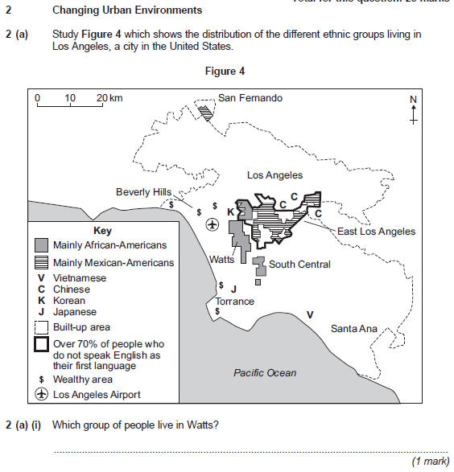
African-Americas [1mk]

Slide 4
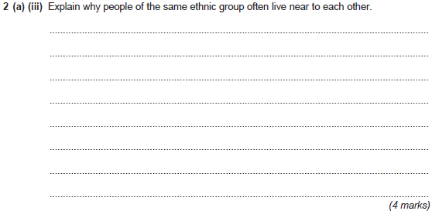
Central west of East LA [1mk]
Inland [1mk]
East of the airport[1mk]
Away from wealthier areas [1mk]
Away from the coast [1mk]
East of the richer areas [1mk]
They feel safer [1mk]
Speak the same language [1mk]
Near family friends [1mk]
Gain support form each other [1mk]
Gain support form each other [1mk] such as religious centres/ community centres or ethnic food shops [2mk]
Near people from their own culture so they can support each other [2mk]
Local services in the local area provide for their particular cultural needs [2mk]

Slide 5
Provide English classes so they can access better employment [2mk]
Develop ethnic areas as tourist attractions such as China town or the curry mile[2mk]
Encourage ethnic mixing to reduce cultural tensions [2mk]
Encourage people to open their own businesses [2mk]

Slide 6
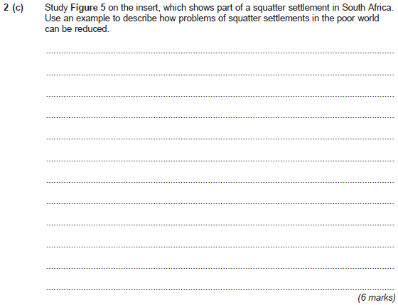
Dharavi
They will put in drainage [1mk]
They provide water taps [1mk]
They build stronger houses [1mk]
Put electricity into hopes [1mk]
Self help schemes help build the foundations of house which is later completed by the resident [2mk]
Water and drainage is put in place to improve hygiene [2mk]
Local authorities provide cheaper housing for people who will move to the town [2mk]
Local authorities provide cheaper building material to improve homes [2mk]
Figure 5

Slide 7
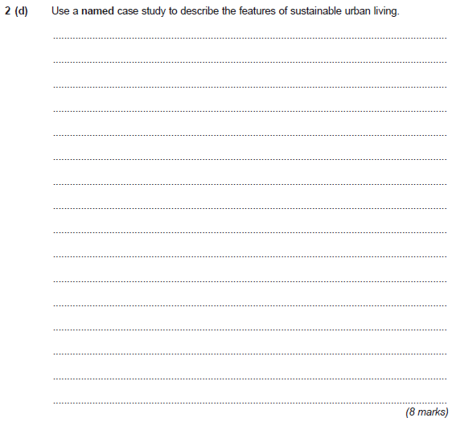
1 -2 mks – Little attempt, poor examples, no structure, little terminology, description only
BedZed
Curitiba
No harm to the environment [1mk]
Use few resources [1mk]
Make use of public transport [1mk]
Provide open spaces [1mk]
7-8 mks – Detailed, Structured answer, Specific examples, good use of terminology, detailed explanation
Grow their own food [1mk]
(BedZed) Grow their own food on allotments for a community [2mk]
(BedZed) Use Biogas to generate electricity [2mk]
(BedZed) Use solar panels to generate electricity [2mk]
(BedZed) Share electric cars between a community of people to save energy [2mk]
(BedZed) Separate waste for compost heaps and recycling [2mk]
(BedZed) Recycle grey water for flushing toilets [2mk]
(Curitiba) Quarries are used for open spaces [2mk]
(Curitiba) Waste collectors are sold rubbish carts to collect an sell waste [2mk]
(Curitiba) Five fast bus routes to encourage people not to use their cars [2mk]

Slide 8
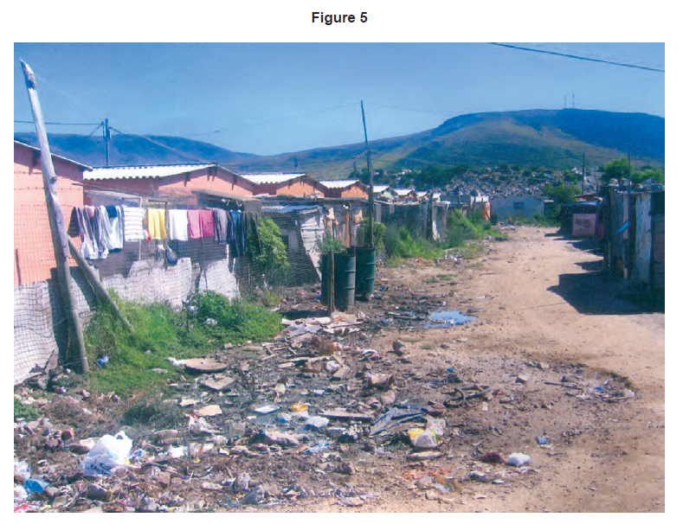
Back

