Slide 1
Structuring examination questions
Understand how to structure examination questions to gain L3 answers on
6-8mk questions
Success Criteria
Level 1 (Basic answers) 1 – 4 marks. (E-D)
Level 2 (Clear answers) 5 – 6 marks (C-B)
Level 3 (Detailed answers ) 7 – 8 marks (A-A*)

Slide 2
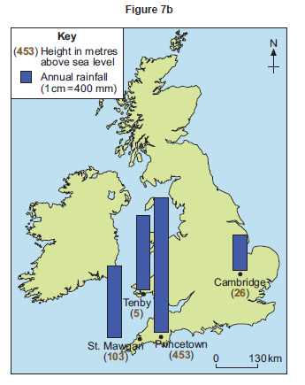
Option 1
Explain the variation in rainfall shown in Figure 7b. You should refer to reasons such as altitude, winds and distance from the sea.(8mks)
Introduction
Re-write the question using the key terms and case study name(s)
Point1 + location from map
Main section
Evaluation/ links to the question
Point 2 + location from map
Evaluation/ links to the question
Point 3 + location from map
Evaluation/ links to the question
Point4 + location from map
Evaluation/ links to the question
Conclusion
Summarise key themes

Slide 3
Option 2
Explain the variation in rainfall shown in Figure 7b. You should refer to reasons such as altitude, winds and distance from the sea.(8mks)
Introduction
Re-write the question using the key terms and case study name(s)
Point1 + location from map (compare)
Main section
Point1 + location from map (compare)
Evaluation/ links to the question)
Point1 + location from map (compare)
Point1 + location from map (compare)
Evaluation/ links to the question)
Point1 + location from map (compare)
Point1 + location from map (compare)
Evaluation/ links to the question)
Conclusion
Summarise key themes relating to technology, economic and social costs

Slide 4
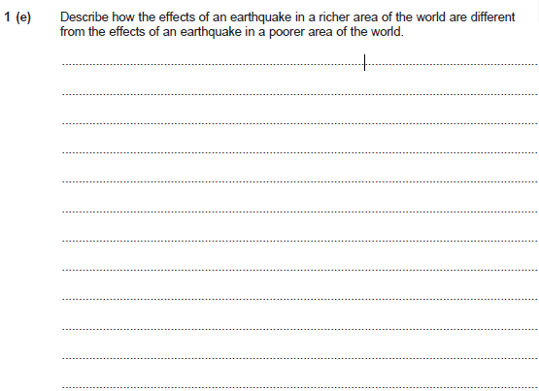
1
Explain the variation in rainfall shown in Figure 7b. You should refer to reasons such as altitude, winds and distance from the sea.(8mks)
Introduction
Different rainfall in the UK occurs due to the variations of altitude, wind and distance from the sea. (Other possibilities)
Level 1 (Basic) 1 – 4 marks
Simple statements.
May be descriptive at times, explanation will be partial /an idea that distance
from the sea is important.
Main section
Tenby and Mawgan tend to be wetter
Princetown and Cambridge are drier
This accounts for a distinct variation because winds will blow off the sea onto the land and will be more moist nearer the coast than inland and rain already fallen by the time Cambridge is reached.
Level 2 (Clear) 5 – 6
Begins to link statements.
Developed statement.
Partial explanation
Clearly explain differences shown.
Reasons relating to winds, distance from the sea or altitude will be clear –
May only cover one in detail.
Princetown is higher
St Mawgan is lower
Level 3 (Detailed) 7 – 8 Statements are more fully developed and linked are made.
There is fuller explanation.
There is an awareness of the links between the reasons – at least two are considered.
This accounts for a distinct variation because altitude exaggerates the effects of rain fall known as relief rainfall.
Conclusion
Clearly the differences in rainfall in different parts of the UK occur due to the variations of altitude, prevailing wind, distance from the sea and to certain extent rain shadow.

